Slide 1

DEPARTMENT OF PHYSICS AND NANOTECHNOLOGY
SRM INSTITUTE OF SCIENCE AND TECHNOLOGY
18PYB103J –Semiconductor Physics
Module-V Lecture-14
Electron Microscopy-Transmission Electron Microscope (TEM)
18PYB103J Module-V Lecture-13

Slide 2
Transmission Electron Microscopy (TEM)
18PYB103J Module-V Lecture-14

Slide 3
Basic Electron Optics
Electrons and ions are charged particles; they can be
accelerated in an electric field
The trajectory of an accelerated charged particle can be
changed (deflected) by E and/ or B field.
The accelerated particles also behave like waves
(de Broglie)
18PYB103J Module-V Lecture-14

Slide 4
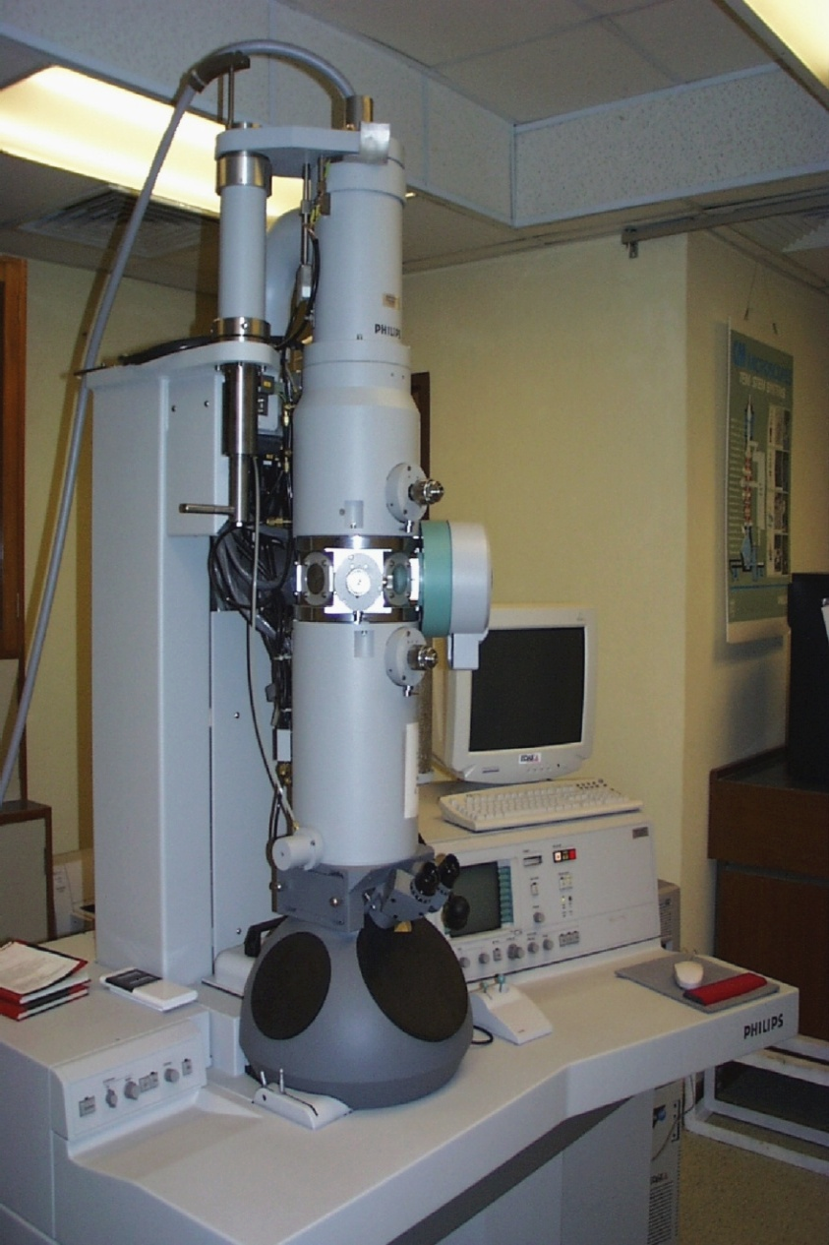
Transmission Electron Microscope (TEM)
Working Concept
TEM works much like a slide projector.
A projector shines a beam of light through (transmits) the slide, as the light passes through it is affected by the structures and objects on the slide.
These effects result in only certain parts of the light beam being transmitted through certain parts of the slide.
This transmitted beam is then projected onto the viewing screen, forming an enlarged image of the slide.
TEMs work the same way except that they shine a beam of electrons (like the light) through the specimen (like the slide).
Whatever part is transmitted is projected onto a phosphor screen for the user to see.
18PYB103J Module-V Lecture-14

Slide 5
Common Modes of Operation of TEM
Bright Field (BF) Microscopy
Selected Area Diffraction
Dark Field (DF)
18PYB103J Module-V Lecture-14

Slide 6
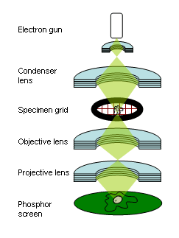
The "Virtual Source" - the electron gun, produces a stream of monochromatic electrons.
This stream is focused to a small, thin, coherent beam by the use of condenser lenses 1 and 2. The first lens (usually controlled by the "spot size knob") largely determines the "spot size"; the general size range of the final spot that strikes the sample.
The second lens (usually controlled by the "intensity or brightness knob" actually changes the size of the spot on the sample; changing it from a wide dispersed spot to a pinpoint beam.
The beam is restricted by the condenser aperture (usually user selectable), knocking out high angle electrons (those far from the optic axis, the dotted line down the center)
The beam strikes the specimen and parts of it are transmitted
18PYB103J Module-V Lecture-14

Slide 7
Unscattered electrons:
Incident electrons which gets transmitted through the specimen without interacting with the sample
Utilization:
Thicker sample- fewer transmitted electrons-appear darker
Thinner sample- more transmission- appear brighter
Elastically scattered electrons:
Incident electrons which gets scattrered by the atoms in the sample elastically (no loss of energy). Then they are transmitted
Utilization:
All electrons follow Braggs condition for scattering
Inelastically Scattered Electrons :
Incident electrons interact with the sample inelastically (loss of energy) and gets transmitted into the specimen
Kakuchi Bands: - Bands of alternating light and dark lines that are formed by inelastic scattering interactions that are related to atomic spacings in the specimen
18PYB103J Module-V Lecture-14

Slide 8
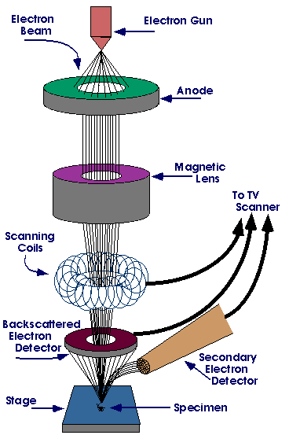
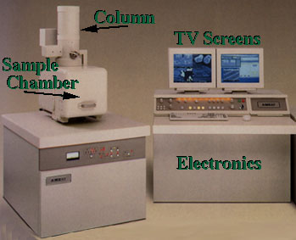
18PYB103J Module-V Lecture-14

Slide 9
AFM - atomic force microscopy
How does the microscope work?
laser
diode
photodiode
mirror
Tip Scans Sample
Up & down movement of the tip is recorded by position sensing photodiode
Si₃N₄ tip
sample
18PYB103J Module-V Lecture-14

Slide 10
Scanning Probe Microscopy—the Atomic Force Microscope (AFM)
The AFM like the STM is a scanning microscope, but the mechanism depends on the force of attraction between molecules
18PYB103J Module-V Lecture-14

Slide 11
Scanning Probe Microscopy—the Atomic Force Microscope (AFM)
The AFM like the STM is a scanning microscope,
but the mechanism depends on the force of attraction between molecules
Cantilever
AFM Tip
Sample
18PYB103J Module-V Lecture-14

Slide 12
Scanning Probe Microscopy—the Atomic Force Microscope (AFM)
The AFM like the STM is a scanning microscope, but the mechanism depends on the force of attraction between molecules
Cantilever
AFM Tip
No current flows between the AFM Tip and sample, so the sample need not be conducting [a requirement for the STM.
Sample
18PYB103J Module-V Lecture-14

Slide 13
Scanning Probe Microscopy—the Atomic Force Microscope (AFM)
The AFM like the STM is a scanning microscope, but the mechanism depends on the force of attraction between molecules
Cantilever
AFM Tip
No current flows between the AFM Tip and sample, so the sample need not be conducting [a requirement for the STM.
Sample
The atoms of the Tip are attracted to the atoms of the sample by the van der Waals interaction.
18PYB103J Module-V Lecture-14

Slide 14
As the AFM tip is attracted to the surface (causing the cantilever to bend), a laser beam bounces off the end of the cantilever—allowing the tip’s movement to be tracked.
18PYB103J Module-V Lecture-14

Slide 15
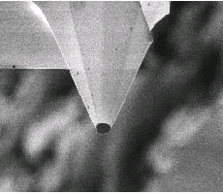
As the AFM tip is attracted to the surface (causing the cantilever to bend), a laser beam bounces off the end of the cantilever—allowing the tip’s movement to be tracked.
~1 μm (1000 nm)
The cantilever is visible to the naked eye but the AFM tip is too small to see without magnification.
18PYB103J Module-V Lecture-14

Slide 16
AFM tip
Surface of sample
The attractive van der Waals interaction acts at a molecular and atomic level, between the AFM tip and the local atoms at the sample’s surface.
18PYB103J Module-V Lecture-14

Slide 17
As the AFM tip scans the surface, its up and down motions map the contour of the sample—scanned line by line.
18PYB103J Module-V Lecture-14

Slide 18
As the AFM tip scans the surface, its up and down motions map the contour of the sample—scanned line by line.
The force on the AFM tip is harmonic (spring like): the tip is displaced toward the surface a distance (Z) proportional to the van der Waals force.
F_{Restore} = Restoring force of cantilever on tip
F_{Restore} = - kZ
Z
k ~ 1 N/m ⇒ An AFM can measure forces of pN (10⁻¹² Newton) & even fN (10⁻¹⁵ N) size!
F_{Sample} = Force of sample pulling on tip (van der Waals)
18PYB103J Module-V Lecture-14

Slide 19
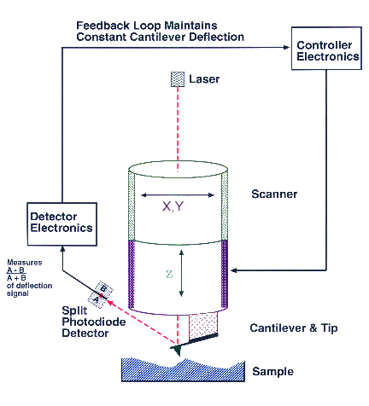
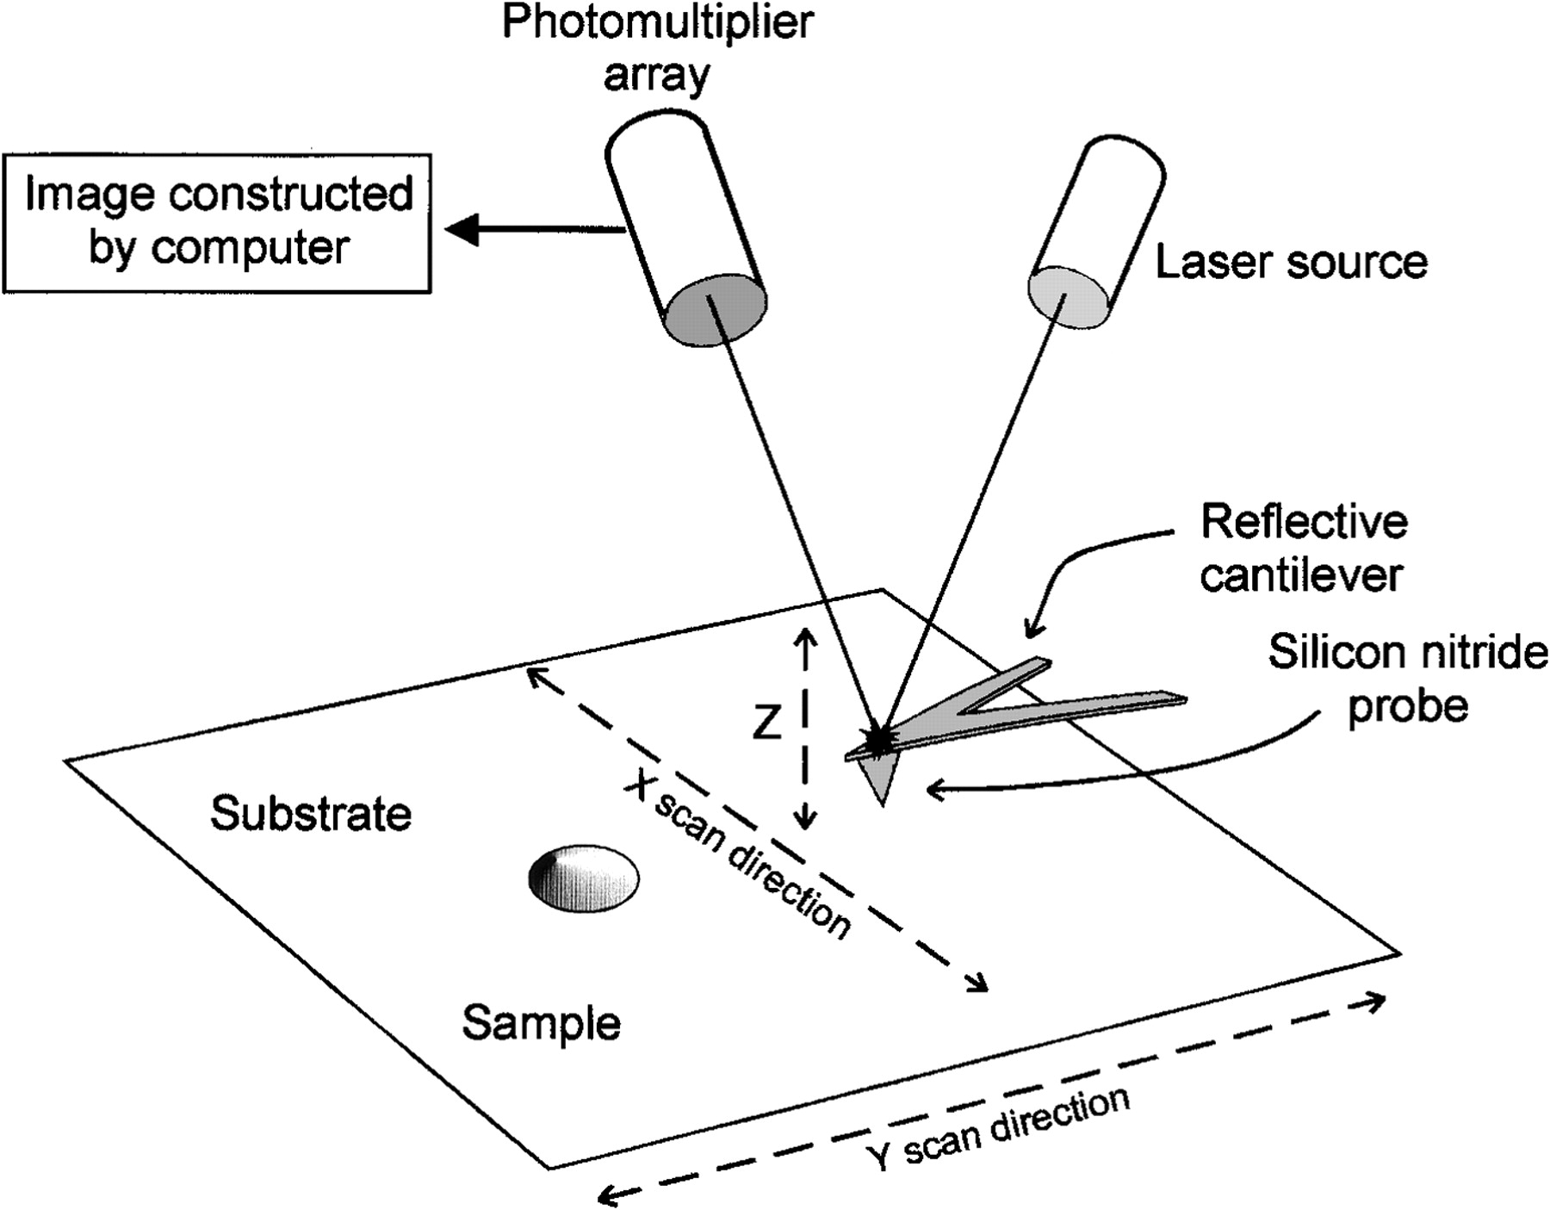
18PYB103J Module-V Lecture-14

Slide 20
IMAGING METHODS
What types of forces are measured ?
-
Modes of operation
-contact
-noncontact
tapping
18PYB103J Module-V Lecture-14

Slide 21
The AFM can operate in three different ways
Contact Mode—the tip is dragged along a sample’s surface; the cantilever deflection is measured and translated into surface shapes. Take care: this mode can damage the surface.
Non-contact mode—the cantilever oscillates above the sample’s surface and is affected by surface/tip forces (van der Waals) as it does so.
Tapping Mode—The AFM tip taps the sample surface during the closest point of approach of an oscillation cycle.
Contact
Intermittent/Tapping
18PYB103J Module-V Lecture-14

Slide 22
ADVANTAGES AND DISADVANTAGES
CONTACT MODE- Fast scanning, good for rough samples
But deforms soft samples
TAPPING MODE- good for biological samples
Slow scan speed and challenging in liquids
NON-CONTACT MODE-low force exerted on the sample
Low resolution contaminant layer can interfere usually need UHV system for good imaging
18PYB103J Module-V Lecture-14

Slide 23
LIMITATIONS OF AFM
Used to study variety of samples
Does not require a conducting sample
Does not reflect the true sample topography
But represents the interaction between the tip and the surface called TIP CONVOLUTION
*Tip broadening – radius of curvature of the tip >size of the feature to be imaged
*As the tip scans the sides of the tip make contact before the apex and the microscope begins to respond to the feature
18PYB103J Module-V Lecture-14

Slide 24
Advantages
The AFM has several advantages over the scanning electron microscope (SEM).
Unlike the electron microscope which provides a two-dimensional projection or a two-dimensional image of a sample, the AFM provides a true three-dimensional surface profile.
Additionally, samples viewed by AFM do not require any special treatments (such as metal/carbon coatings) that would irreversibly change or damage the sample.
While an electron microscope needs an expensive vacuum environment for proper operation, most AFM modes can work perfectly well in ambient air or even a liquid environment.
This makes it possible to study biological macromolecules and even living organisms.
In principle, AFM can provide higher resolution than SEM. It has been shown to give true atomic resolution in ultra-high vacuum (UHV).
18PYB103J Module-V Lecture-14

Slide 25
Disadvantages
A disadvantage of AFM compared with the scanning electron microscope (SEM) is the image size.
The SEM can image an area on the order of millimeters by millimeters with a depth of field on the order of millimeters.
The AFM can only image a maximum height on the order of micrometers and a maximum scanning area of around 150 by 150 micrometers.
Another inconvenience is that at high resolution, the quality of an image is limited by the radius of curvature of the probe tip, and an incorrect choice of tip for the required resolution can lead to image artifacts.
Slow scan and less scanner area
Artefacts/Hystersis effects or cross-talk influences the image
18PYB103J Module-V Lecture-14

